Slide 1
CANCER IN LOS ANGELES COUNTY:
Liver Cancer 2000-2017
Los Angeles Cancer Surveillance Program
USC/Norris Comprehensive Center
The Keck School of Medicine of the University of Southern California

Slide 2
CANCER IN LOS ANGELES COUNTY:
Liver Cancer 2000-2017
Lihua Liu, PhD
Amie Eunah Hwang, PhD
Kai-Ya Tsai, MSPH
James Huynh
Veronica Wendy Setiawan, PhD
Anthony El-Khoueiry, MD
Dennis Deapen, DrPH
2020
Los Angeles Cancer Surveillance Program
USC/Norris Comprehensive Center
The Keck School of Medicine of the University of Southern California
Suggested Citation:
Liu L, Hwang AE, Tsai KY, Huynh J, Setiawan VW, EI-Khoueiry A, Deapen D. Cancer in Los Angeles County: Liver Cancer Incidence, Mortality, and Survival, 2000-2017. Los Angeles Cancer Surveillance Program, Norris Comprehensive Cancer Center, University of Southern California, 2020.
Copyright© 2020 by the University of Southern California.
All rights reserved.
This document, or parts thereof, may be reproduced in any form with citation.

Slide 3
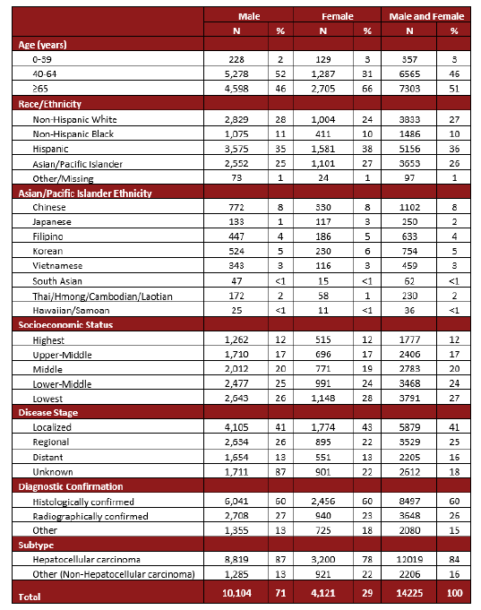
LIVER CANCER STATISTICS BY PATIENT AND TUMOR CHARACTERISTICS
Table 1. Frequency and Distribution of Invasive Liver Cancer Cases by Age, Race/Ethnicity, Socioeconomic Status, Disease Stage and Subtype, Los Angeles County, 2000-2017.
Suggested Citation:
Liu L, Hwang AE, Tsai KY, Huynh J, Setiawan VW, EI-Khoueiry A, Deapen D. Cancer in Los Angeles County: Liver Cancer Incidence, Mortality, and Survival, 2000-2017. Los Angeles Cancer Surveillance Program, Norris Comprehensive Cancer Center, University of Southern California, 2020.

Slide 4
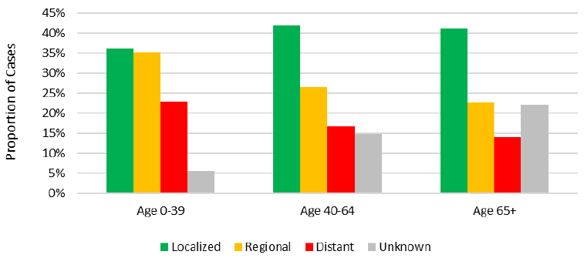
LIVER CANCER STATISTICS BY PATIENT AND TUMOR CHARACTERISTICS
Figure 1A. Distribution of Disease Stage of Invasive Liver Cancer by Age,
Los Angeles County, 2000-2017.
Suggested Citation:
Liu L, Hwang AE, Tsai KY, Huynh J, Setiawan VW, EI-Khoueiry A, Deapen D. Cancer in Los Angeles County: Liver Cancer Incidence, Mortality, and Survival, 2000-2017. Los Angeles Cancer Surveillance Program, Norris Comprehensive Cancer Center, University of Southern California, 2020.

Slide 5
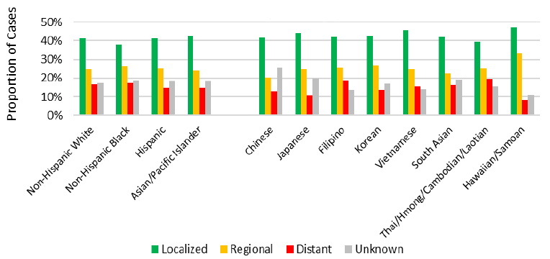
LIVER CANCER STATISTICS BY PATIENT AND TUMOR CHARACTERISTICS
Figure 1B. Distribution of Disease Stage of Invasive Liver Cancer by Race/Ethnicity,
Los Angeles County, 2000-2017.
Suggested Citation:
Liu L, Hwang AE, Tsai KY, Huynh J, Setiawan VW, EI-Khoueiry A, Deapen D. Cancer in Los Angeles County: Liver Cancer Incidence, Mortality, and Survival, 2000-2017. Los Angeles Cancer Surveillance Program, Norris Comprehensive Cancer Center, University of Southern California, 2020.

Slide 6
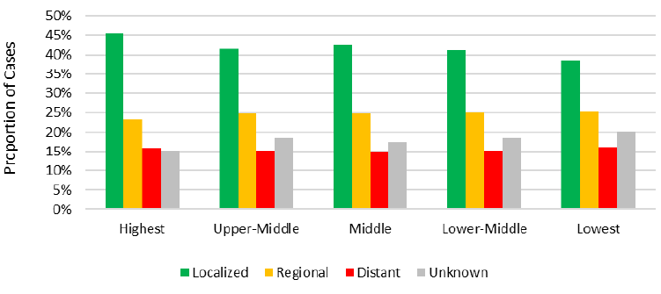
LIVER CANCER STATISTICS BY PATIENT AND TUMOR CHARACTERISTICS
Figure 1C. Distribution of Disease Stage of Invasive Liver Cancer by Socioeconomic Status,
Los Angeles County, 2000-2017.
Suggested Citation:
Liu L, Hwang AE, Tsai KY, Huynh J, Setiawan VW, EI-Khoueiry A, Deapen D. Cancer in Los Angeles County: Liver Cancer Incidence, Mortality, and Survival, 2000-2017. Los Angeles Cancer Surveillance Program, Norris Comprehensive Cancer Center, University of Southern California, 2020.

Slide 7
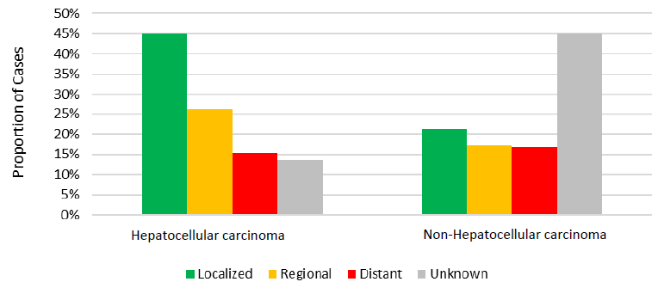
LIVER CANCER STATISTICS BY PATIENT AND TUMOR CHARACTERISTICS
Figure 1D. Distribution of Disease Stage of Invasive Liver Cancer by Subtype,
Los Angeles County, 2000-2017.
Suggested Citation:
Liu L, Hwang AE, Tsai KY, Huynh J, Setiawan VW, EI-Khoueiry A, Deapen D. Cancer in Los Angeles County: Liver Cancer Incidence, Mortality, and Survival, 2000-2017. Los Angeles Cancer Surveillance Program, Norris Comprehensive Cancer Center, University of Southern California, 2020.

Slide 8
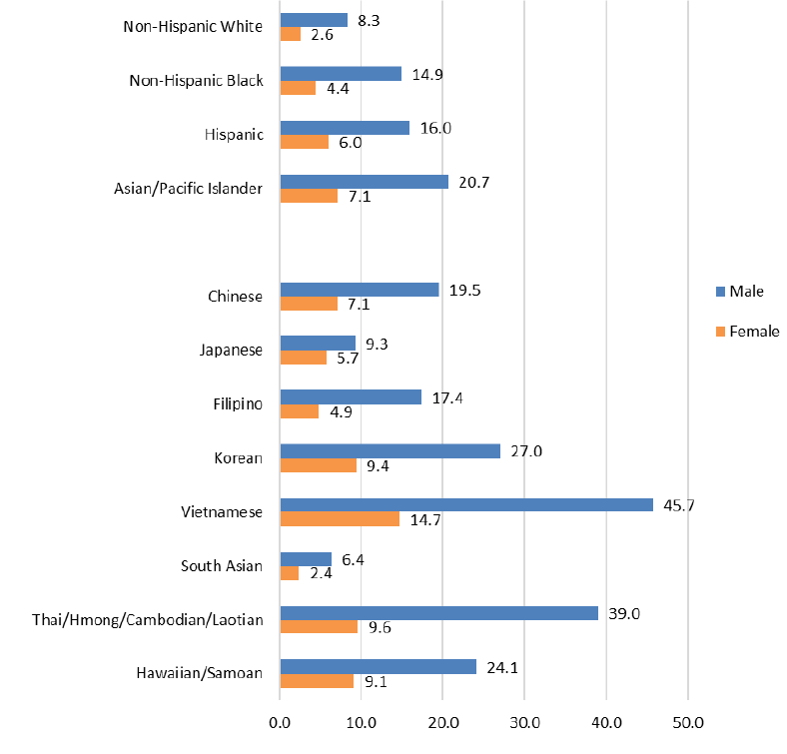
LIVER CANCER STATISTICS BY PATIENT AND TUMOR CHARACTERISTICS
Figure 2. Age-Adjusted Incidence Rates of Invasive Liver Cancer by Race/Ethnicity and Sex (per 100,000 population), Los Angeles County, 2000-2017.
Suggested Citation:
Liu L, Hwang AE, Tsai KY, Huynh J, Setiawan VW, EI-Khoueiry A, Deapen D. Cancer in Los Angeles County: Liver Cancer Incidence, Mortality, and Survival, 2000-2017. Los Angeles Cancer Surveillance Program, Norris Comprehensive Cancer Center, University of Southern California, 2020.

Slide 9
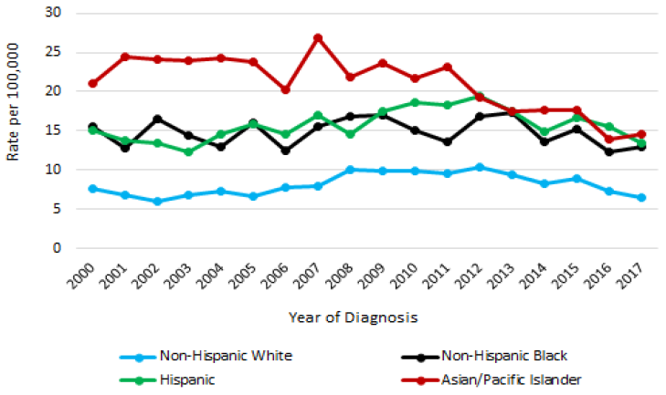
LIVER CANCER STATISTICS BY PATIENT AND TUMOR CHARACTERISTICS
Figure 3A. Annual Age-Adjusted Incidence Rate Trends of Invasive Liver Cancer by Race/Ethnicity among Males, Los Angeles County, 2000-2017.
Suggested Citation:
Liu L, Hwang AE, Tsai KY, Huynh J, Setiawan VW, EI-Khoueiry A, Deapen D. Cancer in Los Angeles County: Liver Cancer Incidence, Mortality, and Survival, 2000-2017. Los Angeles Cancer Surveillance Program, Norris Comprehensive Cancer Center, University of Southern California, 2020.

Slide 10
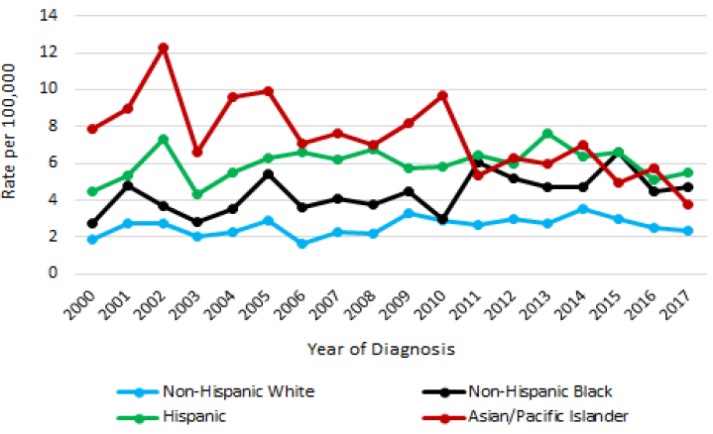
LIVER CANCER STATISTICS BY PATIENT AND TUMOR CHARACTERISTICS
Figure 3B. Annual Age-Adjusted Incidence Rate Trends of Invasive Liver Cancer by Race/Ethnicity among Females, Los Angeles County, 2000-2017.
Suggested Citation:
Liu L, Hwang AE, Tsai KY, Huynh J, Setiawan VW, EI-Khoueiry A, Deapen D. Cancer in Los Angeles County: Liver Cancer Incidence, Mortality, and Survival, 2000-2017. Los Angeles Cancer Surveillance Program, Norris Comprehensive Cancer Center, University of Southern California, 2020.

Slide 11
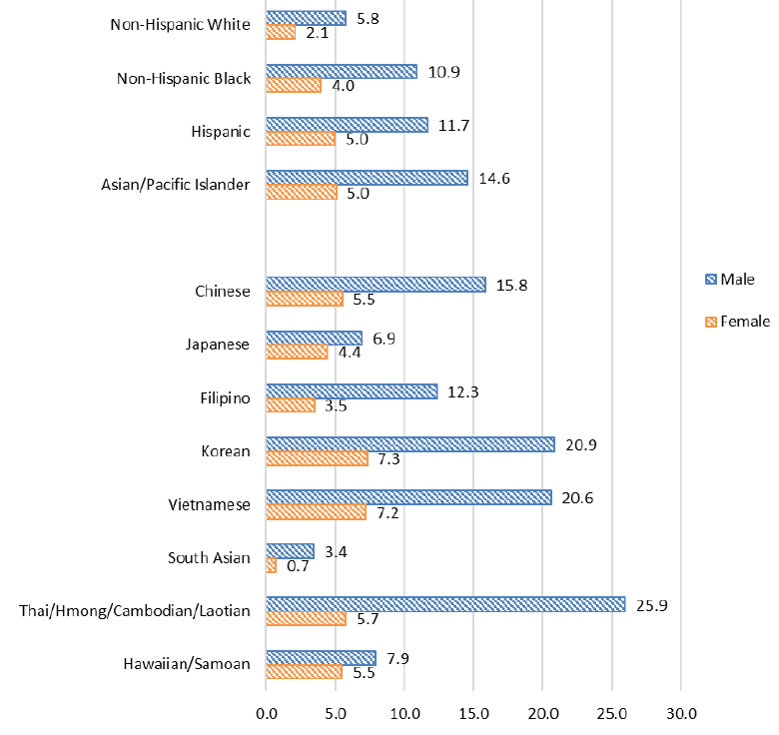
LIVER CANCER STATISTICS BY PATIENT AND TUMOR CHARACTERISTICS
Figure 4. Age-Adjusted Mortality Rates of Liver Cancer by Race/Ethnicity and Sex (per 100,000 population), Los Angeles County, 2000-2017.
Suggested Citation:
Liu L, Hwang AE, Tsai KY, Huynh J, Setiawan VW, EI-Khoueiry A, Deapen D. Cancer in Los Angeles County: Liver Cancer Incidence, Mortality, and Survival, 2000-2017. Los Angeles Cancer Surveillance Program, Norris Comprehensive Cancer Center, University of Southern California, 2020.

Slide 12
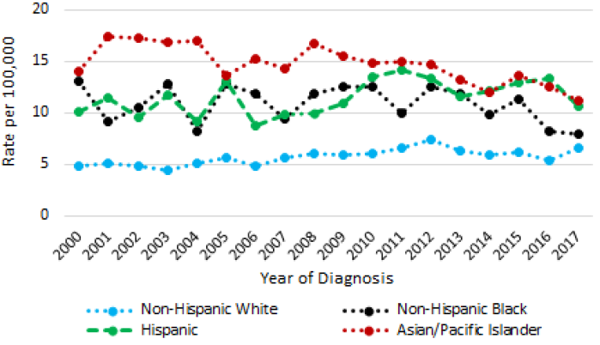
LIVER CANCER STATISTICS BY PATIENT AND TUMOR CHARACTERISTICS
Figure 5A. Annual Age-Adjusted Mortality Rate Trends of Invasive Liver Cancer by Race/Ethnicity among Males, Los Angeles County, 2000-2017.
Suggested Citation:
Liu L, Hwang AE, Tsai KY, Huynh J, Setiawan VW, EI-Khoueiry A, Deapen D. Cancer in Los Angeles County: Liver Cancer Incidence, Mortality, and Survival, 2000-2017. Los Angeles Cancer Surveillance Program, Norris Comprehensive Cancer Center, University of Southern California, 2020.

Slide 13
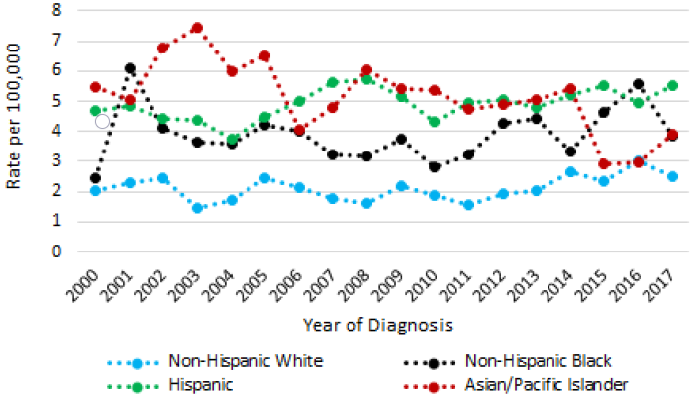
LIVER CANCER STATISTICS BY PATIENT AND TUMOR CHARACTERISTICS
Figure 5B. Annual Age-Adjusted Mortality Rate Trends of Invasive Liver Cancer by Race/Ethnicity among Females, Los Angeles County, 2000-2017.
Suggested Citation:
Liu L, Hwang AE, Tsai KY, Huynh J, Setiawan VW, EI-Khoueiry A, Deapen D. Cancer in Los Angeles County: Liver Cancer Incidence, Mortality, and Survival, 2000-2017. Los Angeles Cancer Surveillance Program, Norris Comprehensive Cancer Center, University of Southern California, 2020.

Slide 14
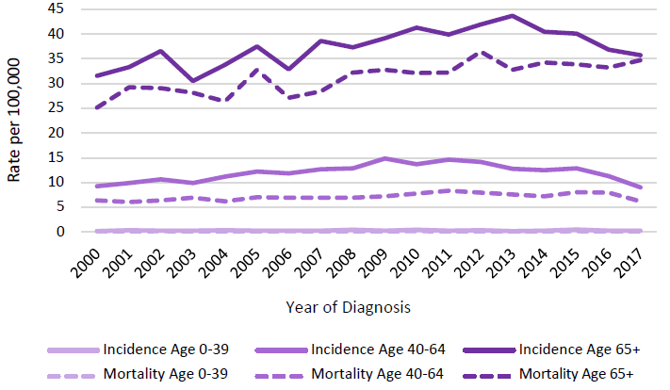
LIVER CANCER STATISTICS BY PATIENT AND TUMOR CHARACTERISTICS
Figure 6. Comparison of Time Trends in Annual Age-Adjusted Incidence vs. Mortality Rates of Invasive Liver Cancer by Age Group (per 100,000 population), Los Angeles County, 2000-2017.
Suggested Citation:
Liu L, Hwang AE, Tsai KY, Huynh J, Setiawan VW, EI-Khoueiry A, Deapen D. Cancer in Los Angeles County: Liver Cancer Incidence, Mortality, and Survival, 2000-2017. Los Angeles Cancer Surveillance Program, Norris Comprehensive Cancer Center, University of Southern California, 2020.

Slide 15
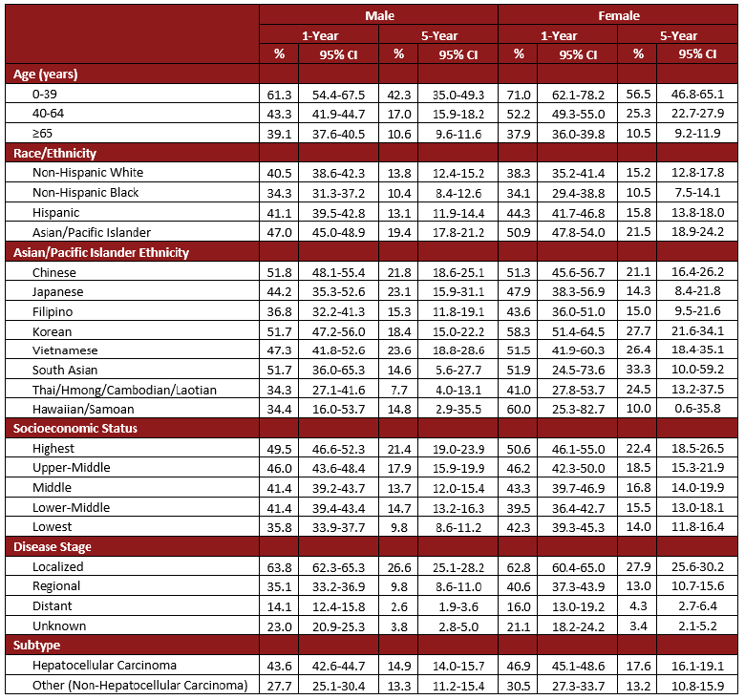
LIVER CANCER STATISTICS BY PATIENT AND TUMOR CHARACTERISTICS
Table 2. One- and Five-year Observed Survival among Invasive Liver Cancer Patients by Sex, Age, Race/Ethnicity, Socioeconomic Status, Disease Stage, and Subtype, Los Angeles County, 2000-2017.
Suggested Citation:
Liu L, Hwang AE, Tsai KY, Huynh J, Setiawan VW, EI-Khoueiry A, Deapen D. Cancer in Los Angeles County: Liver Cancer Incidence, Mortality, and Survival, 2000-2017. Los Angeles Cancer Surveillance Program, Norris Comprehensive Cancer Center, University of Southern California, 2020.
CI: Confidence Interval

Slide 16
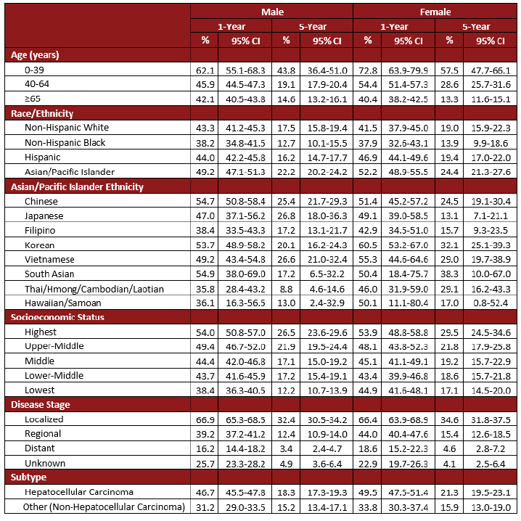
LIVER CANCER STATISTICS BY PATIENT AND TUMOR CHARACTERISTICS
Table 3. One- and Five-year Relative* Survival among Invasive Liver Cancer by Sex, Age, Race/Ethnicity, Socioeconomic Status, Disease Stage, and Subtype, Los Angeles County, 2000-2017.
CI: Confidence Interval
*Relative survival estimates the probability of survival from cancer considering the chances of dying from other causes. It is calculated as a ratio of the observed survival among cancer patients to the expected survival from all causes of death.
Suggested Citation:
Liu L, Hwang AE, Tsai KY, Huynh J, Setiawan VW, EI-Khoueiry A, Deapen D. Cancer in Los Angeles County: Liver Cancer Incidence, Mortality, and Survival, 2000-2017. Los Angeles Cancer Surveillance Program, Norris Comprehensive Cancer Center, University of Southern California, 2020.

Slide 17
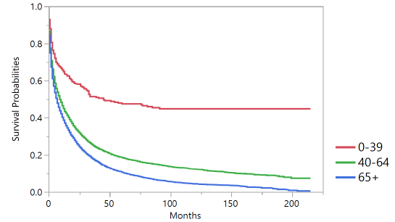
LIVER CANCER STATISTICS BY PATIENT AND TUMOR CHARACTERISTICS
Figure 7A. Kaplan-Meier Observed Survival Curves for Invasive Liver Cancer by Age, Los Angeles County, 2000-2017.
Suggested Citation:
Liu L, Hwang AE, Tsai KY, Huynh J, Setiawan VW, EI-Khoueiry A, Deapen D. Cancer in Los Angeles County: Liver Cancer Incidence, Mortality, and Survival, 2000-2017. Los Angeles Cancer Surveillance Program, Norris Comprehensive Cancer Center, University of Southern California, 2020.

Slide 18
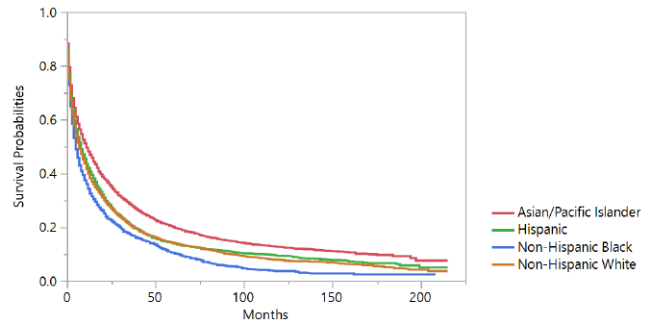
LIVER CANCER STATISTICS BY PATIENT AND TUMOR CHARACTERISTICS
Figure 7B. Kaplan-Meier Observed Survival Curves for Invasive Liver Cancer by Race/Ethnicity, Los Angeles County, 2000-2017.
Suggested Citation:
Liu L, Hwang AE, Tsai KY, Huynh J, Setiawan VW, EI-Khoueiry A, Deapen D. Cancer in Los Angeles County: Liver Cancer Incidence, Mortality, and Survival, 2000-2017. Los Angeles Cancer Surveillance Program, Norris Comprehensive Cancer Center, University of Southern California, 2020.

Slide 19
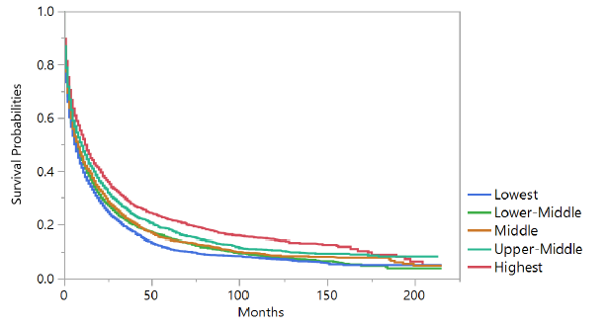
LIVER CANCER STATISTICS BY PATIENT AND TUMOR CHARACTERISTICS
Figure 7C. Kaplan-Meier Observed Survival Curves for Invasive Liver Cancer by Socioeconomic Status, Los Angeles County, 2000-2017.
Suggested Citation:
Liu L, Hwang AE, Tsai KY, Huynh J, Setiawan VW, EI-Khoueiry A, Deapen D. Cancer in Los Angeles County: Liver Cancer Incidence, Mortality, and Survival, 2000-2017. Los Angeles Cancer Surveillance Program, Norris Comprehensive Cancer Center, University of Southern California, 2020.

Slide 20
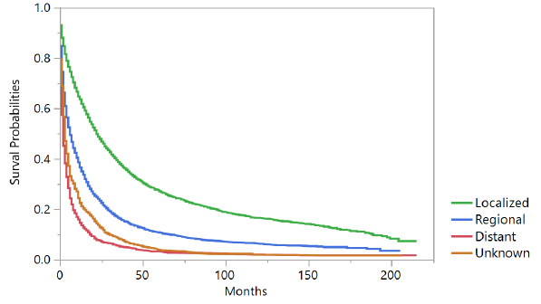
LIVER CANCER STATISTICS BY PATIENT AND TUMOR CHARACTERISTICS
Figure 7D. Kaplan-Meier Observed Survival Curves for Invasive Liver Cancer by Stage, Los Angeles County, 2000-2017.
Suggested Citation:
Liu L, Hwang AE, Tsai KY, Huynh J, Setiawan VW, EI-Khoueiry A, Deapen D. Cancer in Los Angeles County: Liver Cancer Incidence, Mortality, and Survival, 2000-2017. Los Angeles Cancer Surveillance Program, Norris Comprehensive Cancer Center, University of Southern California, 2020.

Slide 21
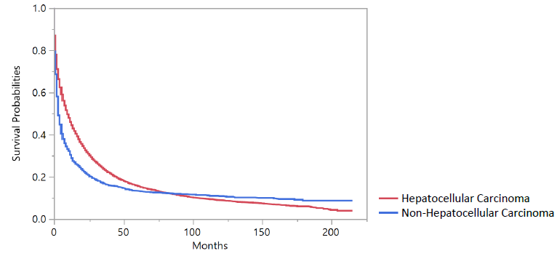
LIVER CANCER STATISTICS BY PATIENT AND TUMOR CHARACTERISTICS
Figure 7E. Kaplan-Meier Observed Survival Curves for Invasive Liver Cancer by Subtype, Los Angeles County, 2000-2017.
Suggested Citation:
Liu L, Hwang AE, Tsai KY, Huynh J, Setiawan VW, EI-Khoueiry A, Deapen D. Cancer in Los Angeles County: Liver Cancer Incidence, Mortality, and Survival, 2000-2017. Los Angeles Cancer Surveillance Program, Norris Comprehensive Cancer Center, University of Southern California, 2020.

Slide 22
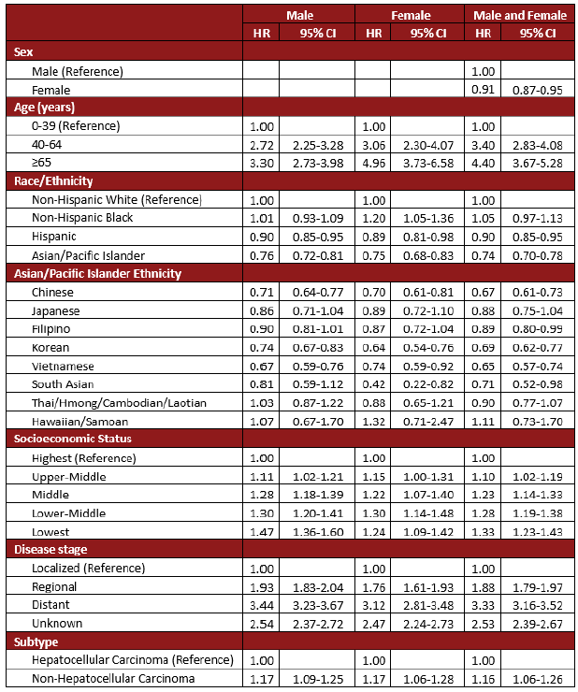
LIVER CANCER STATISTICS BY PATIENT AND TUMOR CHARACTERISTICS
Table 4. Hazard Ratios* for the Associations between Death and Sex, Age, Race/Ethnicity, Socioeconomic Status, Disease Stage and Subtype among Invasive Liver Cancer Patients, Los Angeles County, 2000-2017.
Suggested Citation:
Liu L, Hwang AE, Tsai KY, Huynh J, Setiawan VW, EI-Khoueiry A, Deapen D. Cancer in Los Angeles County: Liver Cancer Incidence, Mortality, and Survival, 2000-2017. Los Angeles Cancer Surveillance Program, Norris Comprehensive Cancer Center, University of Southern California, 2020.
*Hazard ratios (HR) obtained from multivariate Cox regression models adjusting for all variables listed. HR: Hazard Ratio
CI: Confidence Interval

Slide 23
SUMMARY OF LIVER CANCER RISK FACTORS
Cirrhosis
Cirrhosis is the scarring of liver tissue and can be caused by many factors such as viral infections, alcohol consumption, nonalcoholic fatty liver disease, and metabolic syndromes. Regardless of cause, it is the primary risk factor for liver cancer. 1% to 4% of patients with cirrhosis develop liver cancer every year.¹
Chronic Viral Hepatitis
Chronic viral hepatitis from the hepatitis C virus (HCV) and the hepatitis B virus (HBV) are the first and second leading cause of liver cancer in the US, respectively. People with chronic HCV or HBV are at a 15-20 times greater risk of developing liver cancer when compared to healthy individuals.² The latest reported rate for chronic HCV in Los Angeles county was 92 per 100,000 people and 47 per 100,000 people for chronic HBV. Asians and Pacific Islanders regularly account for two-thirds of all annual new chronic hepatitis B cases.³
Heavy Alcohol Consumption
Heavy drinking was associated with a linear increase risk of liver cancer after daily intake of alcohol exceeded 60g.¹ Prolonged alcohol abuse can lead to cirrhosis, the primary risk factor for liver cancer.¹ 16%-17% of adults reported binge-drinking in Los Angeles County in the past 30 days. Between 2000 and 2017, the rate of alcoholic related deaths attributed to liver cirrhosis nearly doubled in Los Angeles.⁴
Non-alcoholic Fatty Liver Disease (NAFLD)
NAFLD has the potential to progress to cirrhosis and eventually liver cancer. Studies have reported an annual 2.6% liver cancer incidence rate for those with cirrhosis due to NAFLD.⁵ NAFLD may also result in the development of liver cancer in the absence of cirrhosis, possibly due to fibrosis or steatosis. Type 2 diabetes and obesity are risk-factors for NAFLD.⁵ Hispanics in California have the highest prevalence of both type 2 diabetes and obesity which may also contribute to them having the highest prevalence of NAFLD.^{6,7}
Diabetes
Studies have shown that those with diabetes are 2-2.5 times more likely to develop liver cancer than those without.⁸ Insulin resistance is a known risk factor for NAFLD, and therefore can also be considered a risk factor for cirrhosis and liver cancer.⁸ In Los Angeles County, the age-adjusted prevalence of diabetes is 7.5%. One-fifth of all adults in Los Angeles aged 60 and over have been diagnosed with diabetes.⁹

Slide 24
SUMMARY OF LIVER CANCER RISK FACTORS
Obesity
60% of people in Los Angeles are either overweight or obese.¹⁰ A meta-analysis of cohort studies found that overweight or obese individuals had a 17% and 89% increased risk of liver cancer, respectively. Obesity is also associated with other risk factors linked to liver cancer, such as diabetes and nonalcoholic fatty liver disease.¹¹
Aflatoxins
Aflatoxins are carcinogens produced by fungi that can grow on agricultural products, such as rice and peanuts. In studies when aflatoxin metabolites was detected in urine, there was 3.8 fold greater relative risk of developing liver cancer. In subjects where both presence of aflatoxins and the hepatitis B virus was detected, there was a 60-fold increase in relative risk.³ California has the highest concentration of Asian/Pacific Islanders in the United States, who are disproportionately overrepresented in chronic hepatitis B cases and are also the highest consumers of rice and grains.¹²
Smoking
Smoking cigarettes moderately increases risk of liver cancer. Current smokers are about 50% more likely than those who have never smoked to develop liver cancer. The risk also appears to increase with amount and length of smoking history.¹³

Slide 25
SUMMARY OF LIVER CANCER RISK FACTORS
REFERENCES
El–Serag, Hashem B., and K. Lenhard Rudolph. "Hepatocellular carcinoma: epidemiology and molecular carcinogenesis." Gastroenterology 132.7 (2007): 2557-2576.
El-Serag, Hashem B. “Epidemiology of viral hepatitis and hepatocellular carcinoma.” Gastroenterology 142.6(2012): 1264-1273.
Los Angeles County-Chronic Hepatitis Cases and Rates of Newly Reported Cases, 2011-2015,California Department of Public Health, Editor. 2017, Office of Viral Hepatitis Prevention.
Los Angeles County of Public Health. "SAPC Data Brief: Excessive Drinking and Consequences". Web Infographic. March 2019. Accessed 4 February 2020
Calzadilla Bertot, Luis, and Leon Anton Adams. “The Natural Course of Non-Alcoholic Fatty Liver Disease.” International journal of molecular sciences 17.5(2016): 774.
Conroy SM, Lee AK, Pendleton L, Bates JH. Burden of Diabetes in California. Sacramento, California: Chronic Disease Control Branch, California Department of Public Health (2014).
Ong, Janus P, and Zobair M Younossi. “Epidemiology and natural history of NAFLD and NASH.” Clinics in liver disease 11.1 (2007): 1-16
El-serag, Hashem B., Thomas Tran, and James E. Everhart. "Diabetes increases the risk of chronic liver disease and hepatocellular carcinoma." Gastroenterology 126.2 (2004): 460-468.
Hales CM, Carroll MD, Kuo T, Simon PA. Diabetes and prediabetes among adults in Los Angeles County and the United States, 1999–2006 and 2007–2014. National Health Statistics Reports; n.123. Hyattsville, MD: National Center for Health Statistics (2019).
Wolstein J, Babey SH, Diamant AL. Obesity in California. Los Angeles, CA: UCLA Center for Health Policy Research, 2015.
Larsson, S C, and A Wolk. “Overweight, obesity and risk of liver cancer: a meta-analysis of cohort studies.” British journal of cancer 97.7 (2007): 1005-1008
Ross RK, Yuan JM, Yu MC, Wogan GN, Qian GS, Tu JT, Groopman JD, Gao YT, Henderson BE. "Urinary aflatoxin biomarkers and risk of hepatocellular carcinoma". Lancet 18.339 (1992):943-946.
Lee, Yuan-Chin Amy, et al. "Meta-analysis of epidemiologic studies on cigarette smoking and liver cancer." International journal of epidemiology 38.6 (2009): 1497-1511.

